Slide 1


Nigeria Meningitis Outbreak Analysis
Data Science Final Project

Slide 2


OUTLINE
Introduction
Problem Description
Source of Dataset
Visualization
Objective
Conclusion

Slide 3

INTRODUCTION

Slide 4
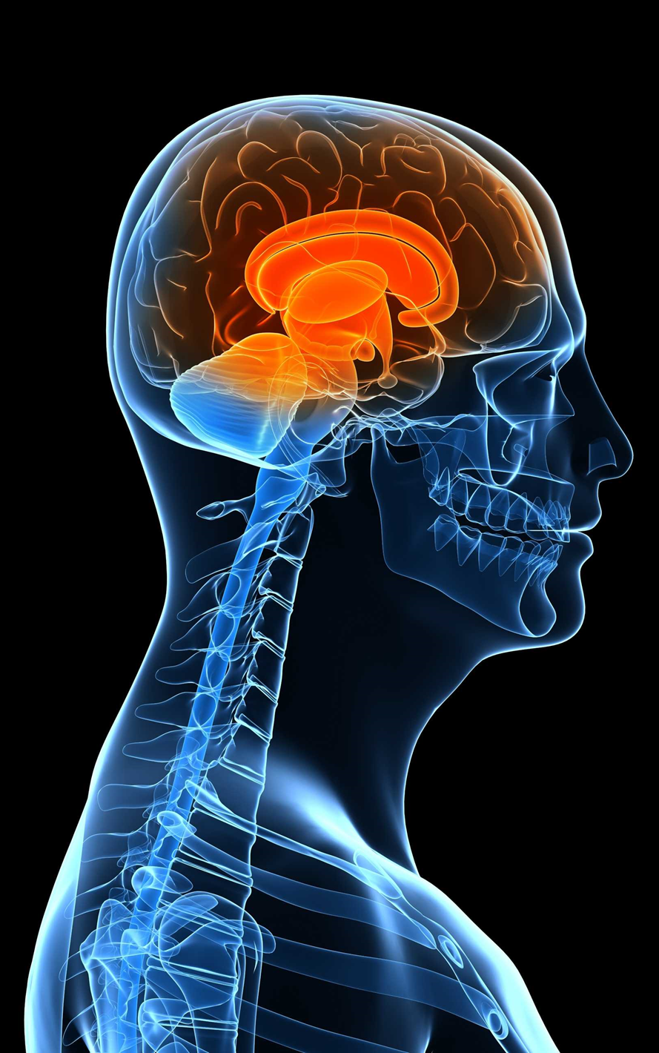

What is Meningitis
?

Slide 5





SYMPTOMS

Slide 6
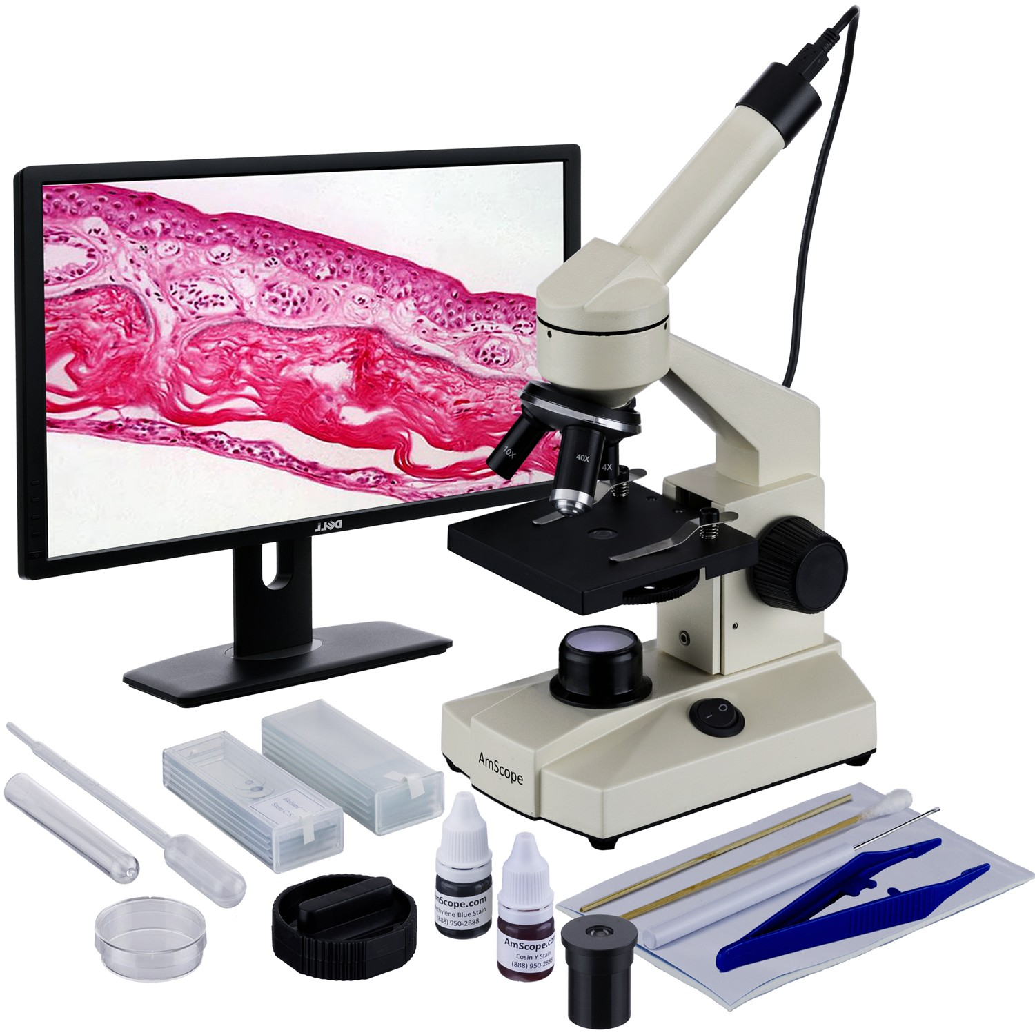

DATA SOURCE

Slide 7

OUR
VISUALISATION

Slide 8
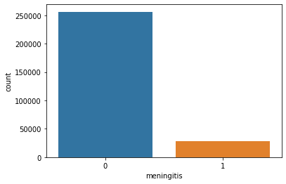
Count plot showing people with and without Meningitis

Slide 9
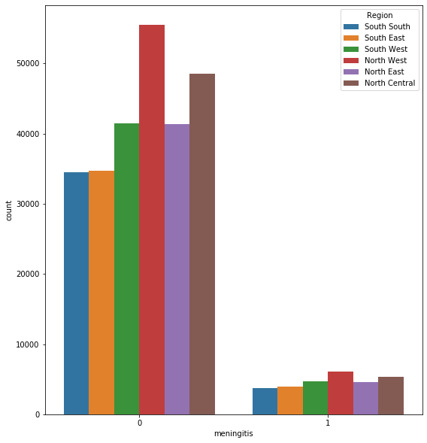
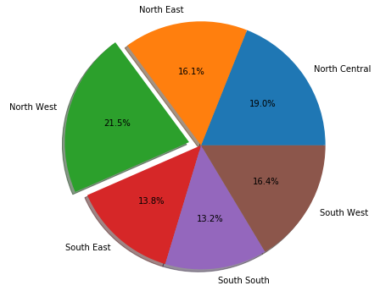
This Pie chart shows the percentage concentration by regions

Slide 10
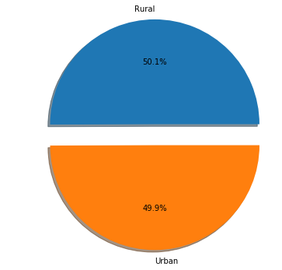
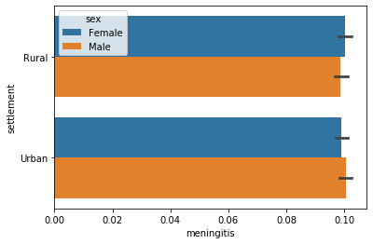
Meningitis percentage concentration by settlement

Slide 11
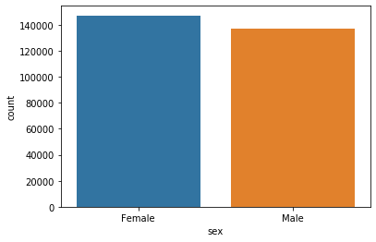
The gender distribution of our dataset

Slide 12
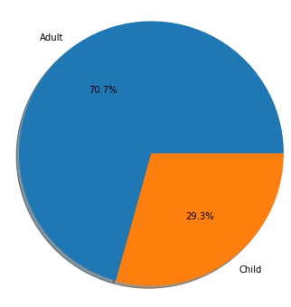
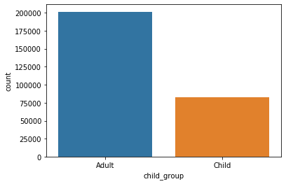
This count plot shows the concentration between adults and children

Slide 13
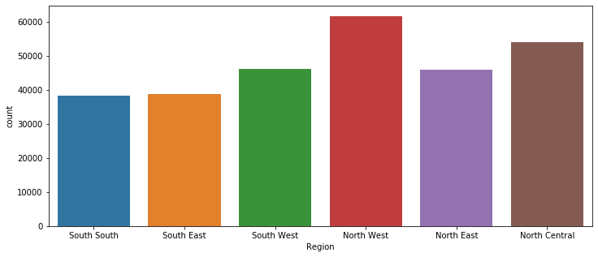
Barplot – Meningitis concentration in every region

Slide 14
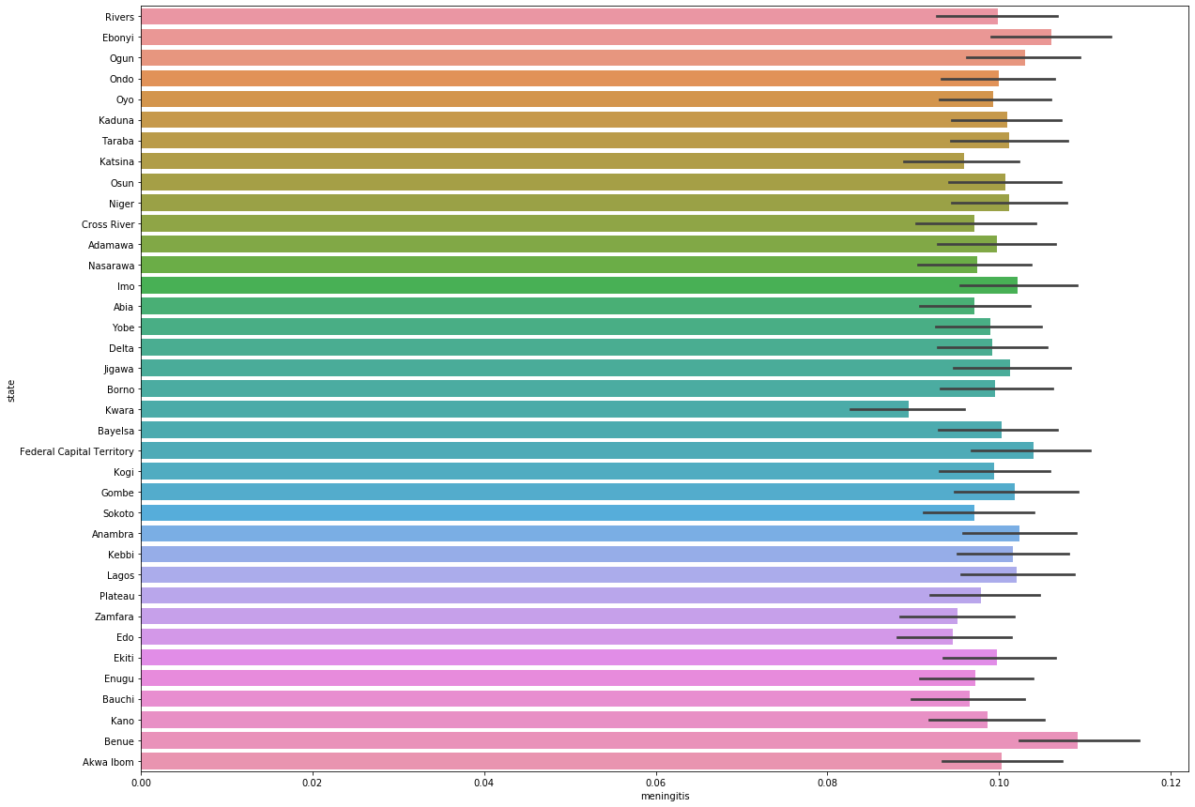
Meningitis concentration by States

Slide 15
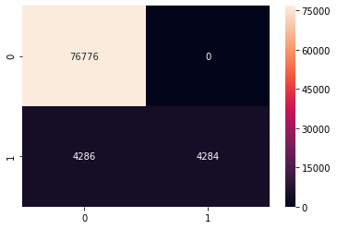
The confusion matrix
Machine Learning Accuracy 95%

Slide 16

Awareness Sensitization Availability of vaccines
OUR RECOMMENDATION

Slide 17
Gbenga Philips Elo-Francis Mairo Omolola Adeyemi
MEET THE TEAM
Seye Oke
Bisi Alonge
Bemigho Blankson

Slide 18

THANK YOU!

